Slide 1
Liver Disease Prediction
🔹🔹🔹🔹🔹🔹🔹

Slide 2
P453 Group 5
Durvanjali Dalvi
Ashish SaWant
Jonathan R
Pratik Sutar
Nelankula Navya
Tehfiz Bijapur
Guggilam Jayasri

Slide 3
Index
Intro
Eda
Model Building
Model Evaluation and accuracy
Deployment
Conclusion
Problems faced

Slide 4
Introduction
Patient data such as demographics, medical history, and biochemical indicators like liver enzyme levels (e.g., ALT, AST), bilirubin, albumin, and others, are analysed.
This is a multiclass classification problem where patients are categorized into groups like hepatitis, cirrhosis, no disease, suspect disease, fibrosis

Slide 5
Exploratory Data Analysis
During exploratory data analysis, we worked with 12 predictors and 615 entries.
Missing values were handled by imputing the median or removing a few entries, as they showed no correlation with other variables.
The data was imbalanced, with the majority in the 'no disease' category (533 entries).
Additionally, no strong correlations were observed among the features, indicating a complex pattern that machine learning could help uncover.
Outliers aren’t handled due to class imbalances

Slide 6
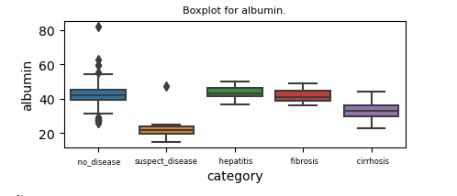
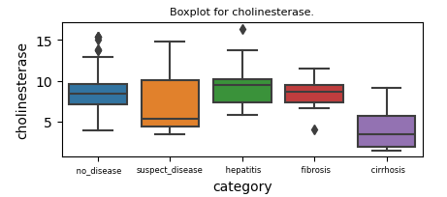
This is the Boxplot for albumin, with respect to various categories, here it was clear that, suspect disease has a less albumin level as compared to other categories.
This is the Boxplot for Cholinesterase, with respect to various categories, here it was clear that, patients who suffered from cirrhosis has a less Cholinesterase level as compared to other categories.
From the boxplot of Protein, it was found that suspect diseased have less protein levels in their body

Slide 7
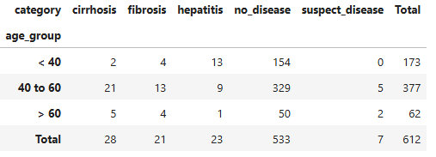
Age Distribution of Patients and Class Imbalance
The dataset includes three age groups, Most entries fall in the 'no disease' category, especially in the 40 to 60 age group
Key Features for Liver Disease Prediction: Based on the PPS score, the top features influencing liver disease classification are:
Aspartate Aminotransferase (AST) - Score: 0.226
Albumin - Score: 0.215
Bilirubin - Score: 0.191
Creatinine - Score: 0.124
Alkaline Phosphatase - Score: 0.101

Slide 8
Model Building
For model building, we employed various algorithms, including Random Forest, Decision Tree, boosting methods like XGBoost and LightGBM, Support Vector Machine (SVM), K-Nearest Neighbors (KNN), and Neural Networks.
The performance of each model was evaluated by comparing their testing accuracy scores to determine the most effective approach for liver disease classification.

Slide 9
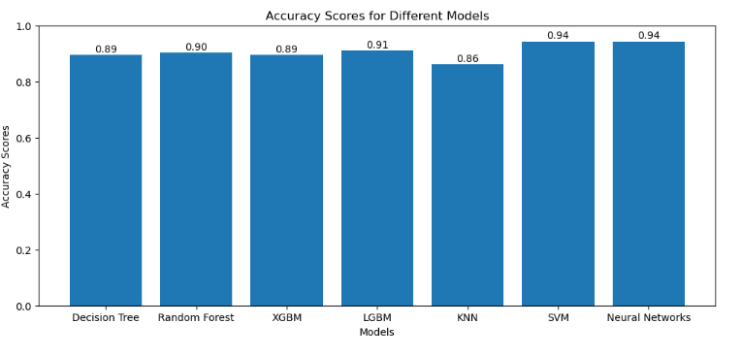
Based on the test accuracy scores, we selected SVM and Neural Networks for further evaluation, as they achieved the highest test accuracy of 0.94

Slide 10
Model Evaluation
Neural Network
Test accuracy: 0.934
Training accuracy: 0.9672
Parameters used: (MLP)
1. activation': 'tanh’
2.'alpha': 0.1 (regualrisation param)
3. 'hidden_layer_sizes': (50,)
4. 'solver': 'adam’ (optimiser)
5. Max iterations set to 200
In neural networks, the dataset was oversampled using the smote method. This was done to improve the overall precision and efficiency of the model.
SVM
Test accuracy: 0.943
Training accuracy : 0.9754
Parameters used:
1. kernel = linear
2. C = 1

Slide 11
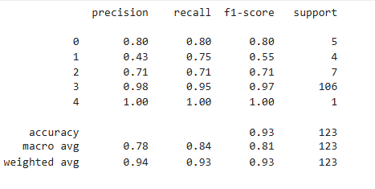
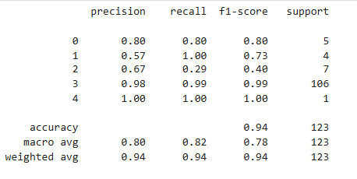
Model Evaluation
Neural Network
SVM
though

Slide 12
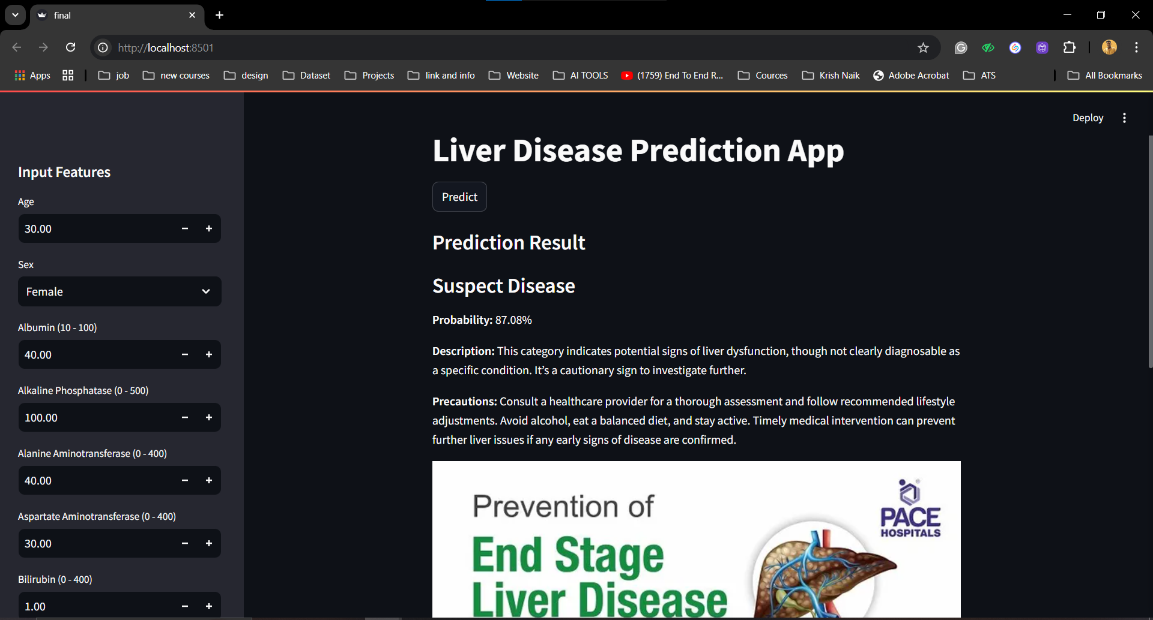
Deployment using Streamlit

Slide 13
Conclusion
Approach:
Outcomes:
Loaded and cleaned the dataset in Jupyter Notebook.
Performed exploratory data analysis (EDA) to understand data patterns.
Tested multiple models, selecting SVM for its high accuracy.
Deployed the model using Streamlit for real-time predictions.
The deployed model reliably predicts liver disease risk.
Provides a probability score to guide users, while emphasizing that results should be confirmed by a healthcare professional.
The system helps users understand potential liver health risks and encourages preventive care.

Slide 14
Problems Faced
Data Imbalance:
Most records indicated no liver disease, making it difficult to train the model accurately.
Solution: Used scaling techniques to improve prediction accuracy.
Limited Dataset Size:
Small dataset size challenged model reliability.
Solution: Enhanced model performance through scaling and data preprocessing.
Deployment Challenges:
Ensured accurate real-time predictions in Streamlit by implementing data scaling at deployment.

Slide 15
THANK YOU

